Slide 1

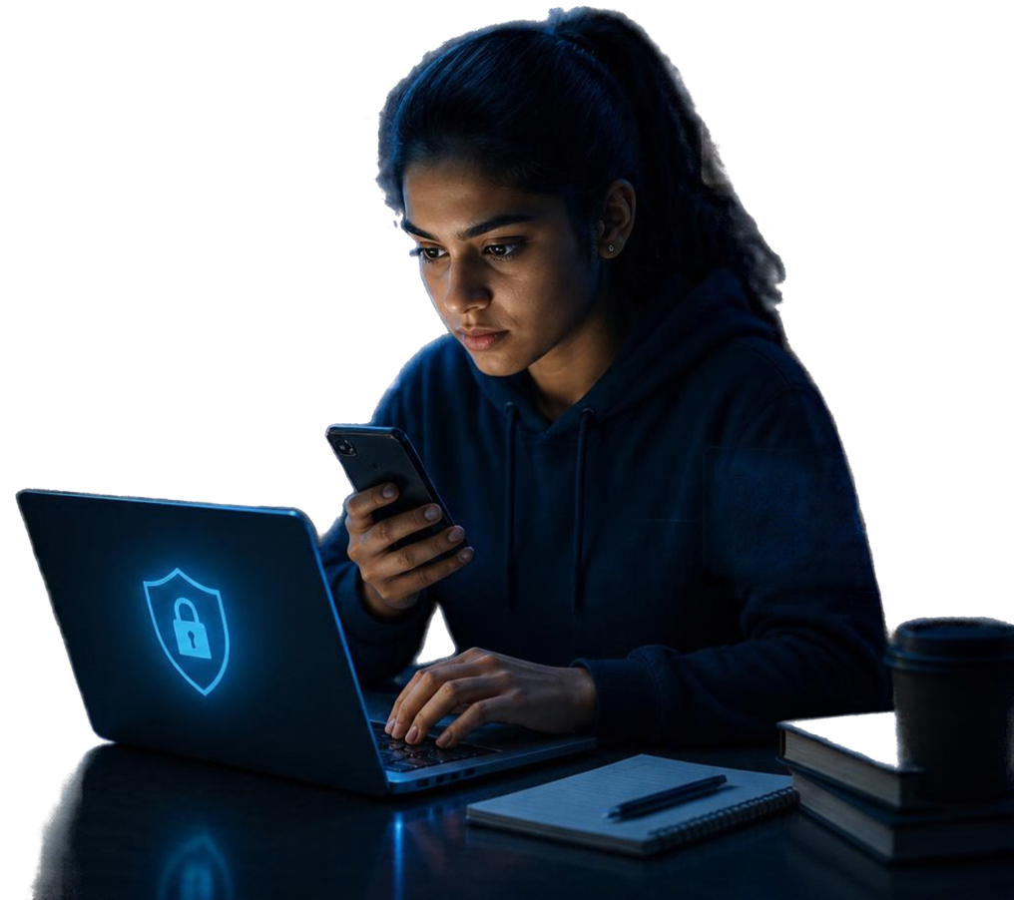










THINK
PHISHING ALERT
Suspicous email detected
VERIFY SOURCES
Don't trust unknown messages
BEFORE YOU
CLICK
PROTECT
your data
and privacy
SUSPICIOUS LINK
This site may be
unsafe
A Student Cybersecurity Awareness Initiative
CHECK QR
Scan safely,
stay secure
Recognize. Think. Verify. Stay Safe.
Presented by
Ancy Alex

Slide 2
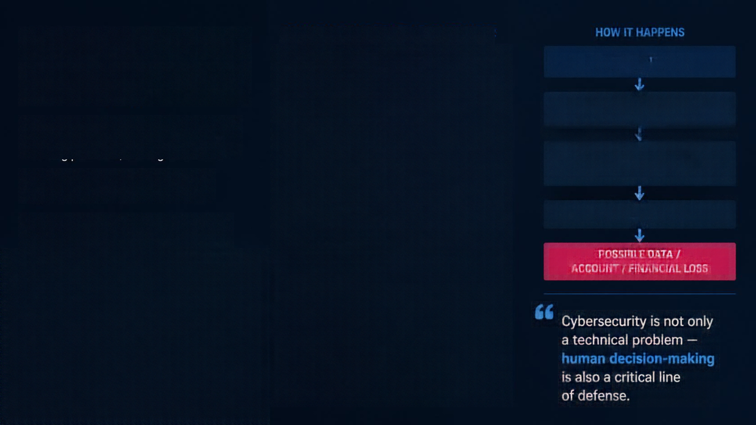












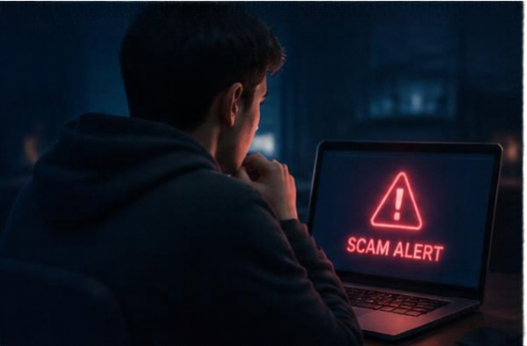



THE PROBLEM
COMMON SCAMS STUDENTS ENCOUNTER
HOW IT HAPPENS
Fake emails or messages designed to steal credentials or information
HIGH DIGITAL USAGE
Students face social engineering threats every day.
PHISHING
LOW PRACTICAL AWARENESS
Students spend significant time on email, social media, messaging apps, online learning platforms, and digital services
FAKE INTERNSHIP SCAMS
Fraudulent internship offers that collect money
or personal data
FAILURE TO RECOGNIZE
WARNING SIGNS
Attackers exploit human psychology beyond technical vulnerabilities
Attackers pretend to be friends, teachers, recruiters, or trusted organizations
UNSAFE DECISION
Social engineering manipulates urgency, fear, curiosity, trust, authority,
and attractive offers
IMPERSONATION
POSSIBLE DATA /
ACCOUNT / FINANCIAL LOSS
SUSPICIOUS LINKS
Links that redirect to
unsafe or fraudulent
websites
Cybersecurity is not only a technical problem — human decision-making is also a critical line
of defense.
QR-CODE SCAMS
Unexpected QR codes
that lead to unsafe
actions or data theft

Slide 3
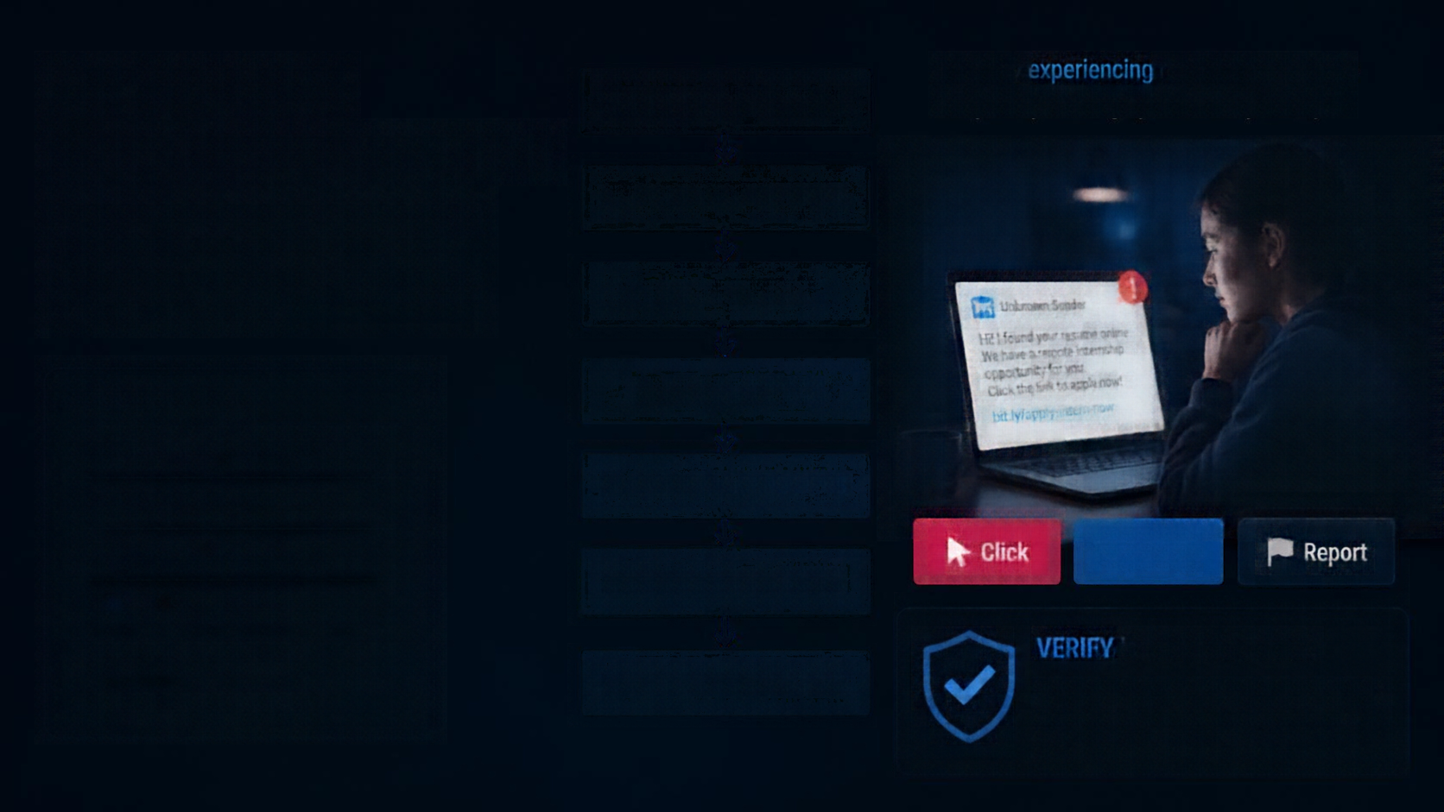


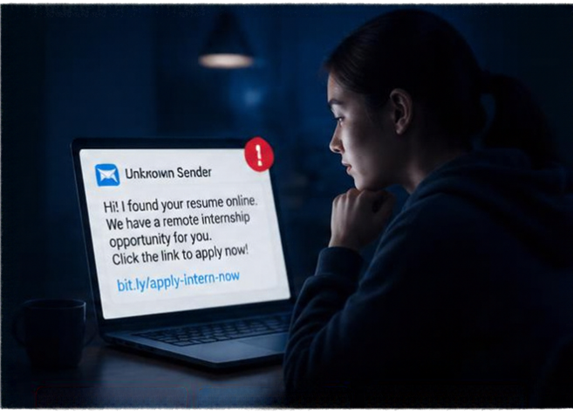







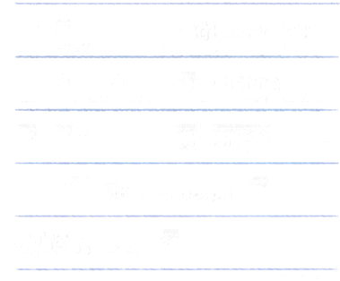













Our Solution:
Learn by experiencing realistic situations – not just by reading cybersecurity theory.
REALISTIC CYBER SCENARIO
Think Before You Click
An interactive cybersecurity awareness platform that teaches students to recognize social-engineering attacks through realistic situations and immediate feedback.
STUDENT MAKES A DECISION
THREAT ANALYSIS
Phishing Challenge
IMMEDIATE FEEDBACK
Fake Internship Scam Detection
Social-Media Impersonation
LEARN THE WARNING SIGNS
Suspicious Link Awareness
Click
Verify
Report
CYBER AWARENESS SCORE
QR-Code Scam Awareness
Cyber Awareness Score
VERIFY is the safer choice.
IMPROVE FUTURE DECISIONS
Verifying helps you confirm the sender, protect your personal data, and avoid falling victim to social-engineering attacks.
Personalized Safety Tips

Slide 4
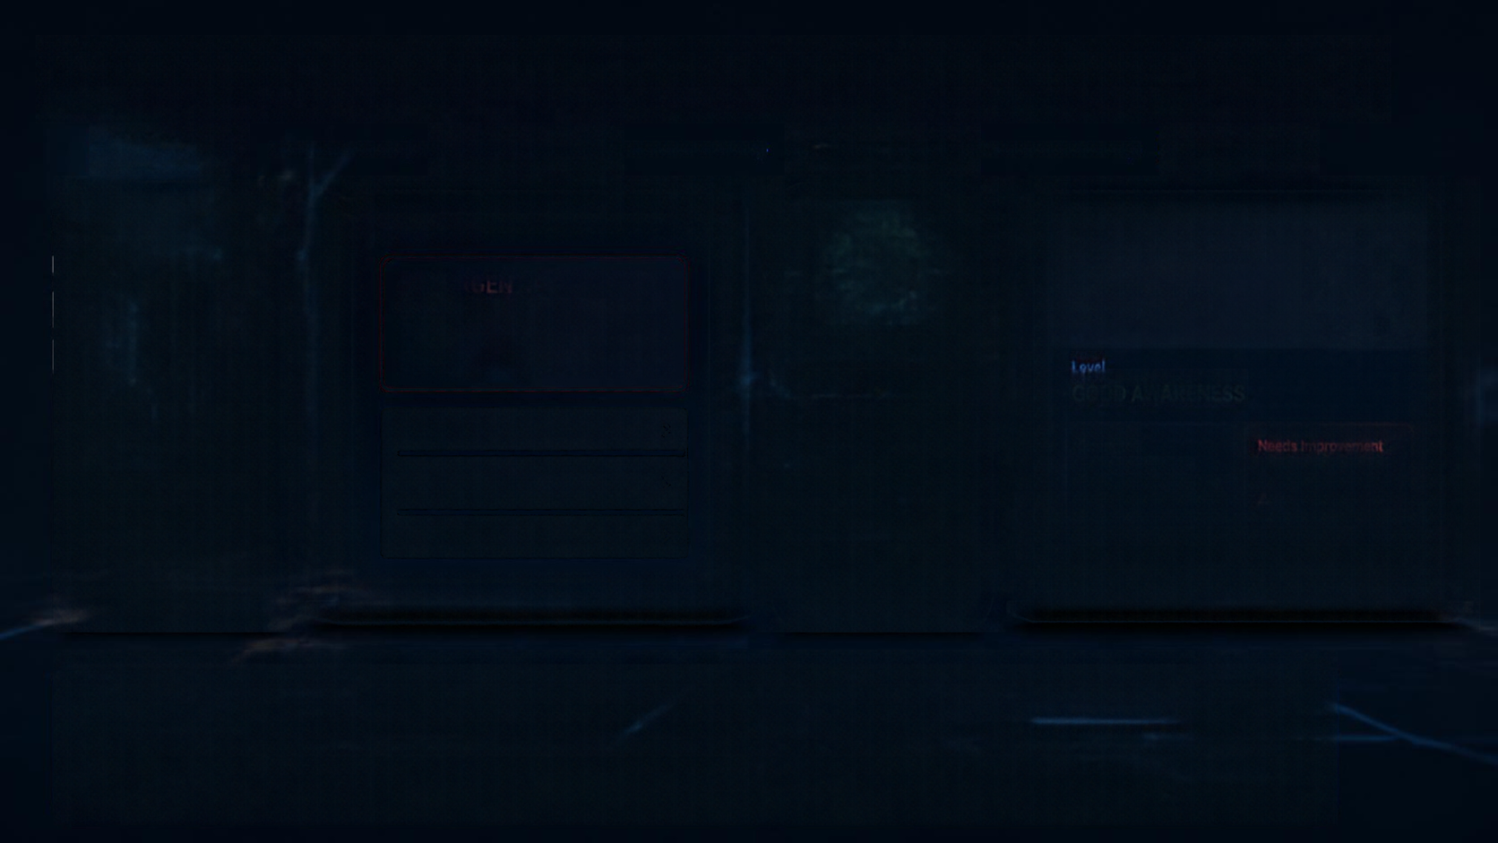
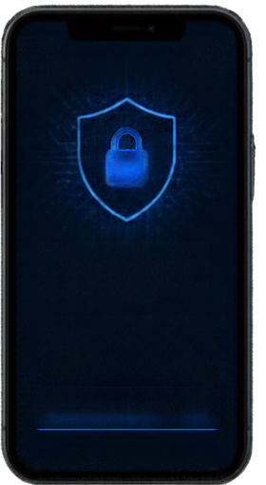

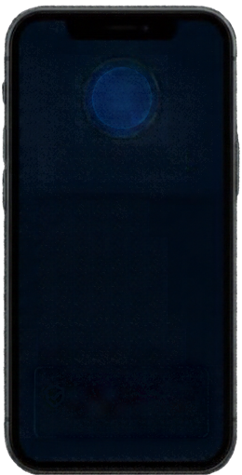




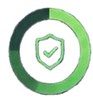





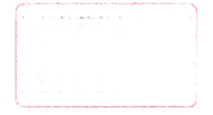






Prototype: Interactive Cybersecurity Awareness Platform
HOME SCREEN
SCENARIO SCREEN
FEEDBACK SCREEN
RESULT SCREEN
New Message
Cyber Awareness Score
URGENT:
82/100
Your college account will be suspended today. Verify your account immediately.
Good Choice!
Warning Signs
Level
GOOD AWARENESS
Think Before You Click
Click the link
Urgency
Threatening language
Suspicious link
Unexpected request
Strengths
Needs Improvement
Test your ability to recognize digital threats.
Verify through the official college website
✔ Phishing detection
⚠ Impersonation scams
Recommended Action
✔ Suspicious-link awareness
⚠ Fake internship scams
Forward the message
Verify through an official channel before taking action.
Start Challenge
From Awareness → To Better Decisions
The platform transforms cybersecurity awareness from passive learning into interactive decision-making, helping students recognize threats, understand warning signs and make safer digital choices.
Think Before You Click.
Pause. Verify. Stay Safe.

